Slide 1
American Government and Economic Systems
Joel Wussler
Nicole Telesco

Slide 2
Background
B.A. Economics
East Stroudsburg University
5 Years in banking/commercial lending
Teacher Certification
UNC Charlotte
Masters of Classroom Technology
Wilkes University
Teaching since 1996
In the district since 1999 (CB West and CB South)

Slide 3
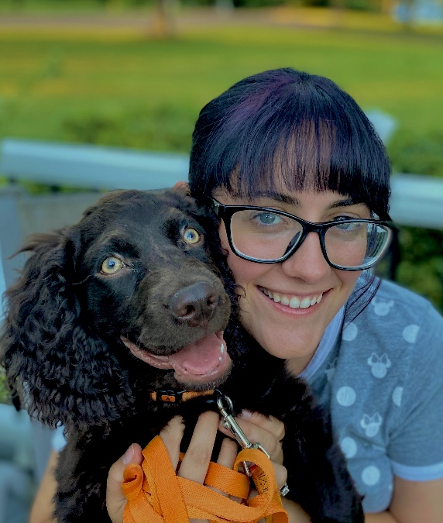
Meet Ms. T
Ms. Nicole Telesco
Education –
Central Bucks High School West 2013
West Chester University 2017
Early Grades & Special Ed
2018-2019: Bucks County Intermediate Unit
Autism, Multiple Disabilities, and Emotional Support Classrooms K-12
18-21 Transition Programs
2019-2020: Holicong Middle School
8th Grade Learning Support

Slide 4
Goals of the Course
Gain an understanding of the general workings of our political and economic systems and how they interconnect
What their rights, roles and responsibilities are as citizens of the United States
Becoming a more informed citizen

Slide 5
Assessment
1st MP Grade 37%
2nd MP Grade 37%
Core Assessment #1 10%
Core Assessment #2 10%
Final Exam 6%

Slide 6
Other Information
Textbooks
Online access through MyCBSD
Canvas - Used on a daily basis
Directions for becoming an observer on Canvas can be found on my Schoolwires homepage
Contacting us:
E-mail is always most efficient
jwussler@cbsd.org
ntelesco@cbsd.org
Office Hours for both:
8:49am – 10:09am, 1:30pm – 2:50pm

